Slide 1
How web browser security really works: the intricate details
David Simner
Notes:
For talk:
Firewall settings -> Add client IP, Save: https://portal.azure.com/#resource/subscriptions/6a73a5e7-68ff-4f4e-a299-fe3baa475693/resourceGroups/make-pizza.info/providers/Microsoft.Sql/servers/catsatdevweek2016
Reset name to ‘Mia Kat’
Delete all the sessions
Alignment of https://www.papaya.me.uk/cats/ontop.html
Chrome:
Which extensions are enabled
Clear browsing data
Complete cycle of https://www.catsatdevweek2016.co.uk/ to warm the site + cache
Open:
Zoom It
https://www.catsatdevweek2016.co.uk/
https://www.papaya.me.uk/cats/ontop.html
https://www.papaya.me.uk/cats/frameswitch.html
https://www.papaya.me.uk/cats/framecount.html
https://www.papaya.me.uk/cats/image.html
https://www.papaya.me.uk/cats/timing.html
https://www.papaya.me.uk/cats/csrf.html
Code for AccountController.cs
Wireshark
Hashing timing demo
Code for LoginService.cs
http://evil.www.catsatdevweek2016.co.uk/setcookie.html
SQL Server client

Slide 2

www.davidsimner.me.uk david.simner@red-gate.com
David Simner

Slide 3
How web browser security really works: the intricate details
Why is this important?
Threat models
Same-origin policy
Brief interlude
Cookies
Subresource Integrity (SRI)

Slide 4
Why is this important?

Slide 5
The landscape
Web server
Users
Web browsers
Attackers

Slide 6
The attacker’s choice
Attack our web server
Attack our users’ web browsers
Notes:
To attack us, the attacker has 2 choices:
Number 1. They attack our web server directly, by connecting to it, and sending data to it, etc. This is a very important topic, and for a secure web site you need to get it right, but, it’s not what this talk is mainly about, so we’re not going to be focussing on it or covering it in any detail. There is however gonna be a brief interlude in the middle of this talk when we look at it, but it’ll be very brief, and as I said, it’s not what this talk is mainly about.
The other choice the attacker can make is…
Number 2. They attack our users’ web browsers. So, how would that work? Well.
The attacker get our users to visit a website that they control, say by having it trend on Twitter, or a plain old advertising campaign, or, whatever.
Now, what can the attacker do if they can manage to get one of our users to visit a website that they control?
Well.
That is what this talk is all about.
This talk is about how web browser security really works.
In today’s web browsers, with those nice tabs – we didn’t have those when I was a kid – what can an attacker do if in one tab is their website and in another tab is our website?
If two tabs have websites from different domains – our domain and the attacker’s domain – how isolated are they?
What can the attacker do, so that the web browser does something we wish it didn’t do?

Slide 7
Guiding principles for today’s talk
What security guarantees do web browsers make?
What don’t they protect against (by default)?
How do you deal with that?
Notes:
If the web browser isn’t protecting you, then you need to do something yourself
There are various ways you can deal with it, for example, sometimes:
You can set a HTTP header to get the web browser to behave in a more secure way
You can write some JavaScript code that runs on the web browser
You can write some server-side code
Or, you can accept the risk. Whether you’re prepared to do that or not, depends on many factors, but, in general, in life, doing nothing is always an option. And it’s an option here too. Whether you take that option or not is up to you ☺
So, even though today’s talk is about web browsers, we’ll very occasionally see some server-side code, because, sometimes, that’s where we need to defend against an attack on our users’ web browsers.
Oh, also, for what I’m gonna talk about today, the web browsers are pretty much the same, so to save time and reduce boring duplication, we’re only gonna focus on Chrome, but it’s pretty much the same whatever web browser it is.

Slide 8
Today’s example
https://www.catsatdevweek2016.co.uk/
Notes:
Audience poll: put your hand up if you’ve heard of Ashley Madison?

Slide 9
Threat models

Slide 10
Threat model
“Attacker-centric threat modelling starts with an attacker, and evaluates their goals, and how they might achieve them.”
Implicit in this is what their capabilities are
Notes:
From Wikipedia
https://en.wikipedia.org/wiki/Threat_model

Slide 11

Protect the credit cards!
Notes:
PCI DSS
https://en.wikipedia.org/wiki/Payment_Card_Industry_Data_Security_Standard

Slide 12
Same-origin policy

Slide 13
Demo
https://www.papaya.me.uk/cats/ontop.html
Notes:
papaya.me.uk owns the outermost frame, i.e. the viewport
It can put a password input on top, mimicking the CSS so it looks like the real thing
It can therefore steal whatever is typed into this input, i.e. the password
Using tab to get to the field is safe, but using the mouse to get to the field is dangerous

Slide 14
Demo
https://www.papaya.me.uk/cats/frameswitch.html
Notes:
papaya.me.uk owns the outermost frame, i.e. the viewport
It can change the URL for the child frame in the cats site to be whatever it likes
This frame can change its name in its parent frame, essentially controlling a global variable
The cats site has debugging code that sends AJAX requests to the testrunner, but now the “testrunner” is the evil site
It can therefore steal whatever the cats site sends it, i.e. the password

Slide 15

Tip: X-Frame-Options
Set the response header:
X-Frame-Options
Notes:
DENY, SAMEORIGIN, ALLOW-FROM uri
On every page on the site, including error pages
https://developer.mozilla.org/en-US/docs/Web/HTTP/X-Frame-Options

Slide 16
Demo
https://www.papaya.me.uk/cats/framecount.html
Notes:
papaya.me.uk launches the tab (as a popunder it wouldn’t be noticeable)
Because of the same-origin policy what it can do with the tab is highly limited, but…
It can get the number of child frames in the tab
Previously we saw how it could change a child frame’s URL – it can only do that when it puts the cats site into an iframe, when it launches it as a tab, it can’t change it
It can therefore deduce if the page redirected to the login page
X-Frame-Options hasn’t helped, because it is launching it as a tab/popunder, which X-Frame-Options doesn’t protect against
You can defend against this by having some JavaScript to detect when your page is opened by somebody else

Slide 17
Demo
https://www.papaya.me.uk/cats/image.html
Notes:
onload vs onerror

Slide 18
Demo
https://www.papaya.me.uk/cats/timing.html
Notes:
Time until onerror is called

Slide 19
Demo
https://www.papaya.me.uk/cats/csrf.html
Notes:
Even if you only AJAX to an endpoint, an attacker can form submit to it, and your framework might not notice (because abstraction)
https://github.com/DavidSimner/cats/blob/master/Controllers/AccountController.cs

Slide 20
Tip: CSRF protection
Protect everything:
Form submissions
AJAX submissions
Log In
Log Out
Notes:
What we did in DLM Dashboard

Slide 21
Brief interlude

Slide 22

HTTPS
https://www.ssllabs.com/ssltest/
Notes:
Audience poll
Not all HTTPS is equal. And just like at school, you want that ‘A’ grade.

Slide 23
HTTPS
Because open Wi-Fi is prevalent
Because SEO
Because soon Chrome will mark HTTP as non-secure
Because it’s easy: CloudFlare, Let's Encrypt, etc…
Because it’s not computationally expensive today
Because Edward Snowden
Because just do it already
Notes:
Just make sure the certificate is valid!
Apple, Google, and Microsoft have all had invalid certificates on production:
Apple: http://uk.businessinsider.com/mac-users-locked-out-of-apps-after-apples-security-certificate-expires-2015-11
Google: http://www.securityweek.com/google-lets-smtp-certificate-expire
Microsoft: https://azure.microsoft.com/en-gb/blog/windows-azure-service-disruption-from-expired-certificate/
https://www.chromium.org/Home/chromium-security/marking-http-as-non-secure

Slide 24
Demo
Wireshark
Notes:
Domain is visible:
DNS
SNI

Slide 25

Obligatory SQL injection slide
Notes:
https://xkcd.com/327/

Slide 26
Account presence leaking
All the same-origin policy stuff we’ve already seen
Failure messages for:
Account creation
Account login failed
Account password reset
Notes:
Re-inforce that client security isn’t everything

Slide 27
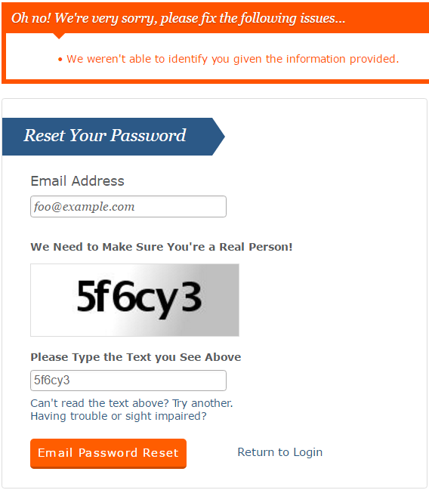
Bad
Notes:
The correct way to do this is for the message on the webpage to always be the same “we’ve sent an email to that address”
And then the contents of the email would vary
If there’s an account, it has password reset instructions
If there isn’t an account, it has a message saying here’s how to sign up, sorry that email address isn’t on file
That way you only leak the presence of an account to the account holder, because by email, you know you’re reaching that person, and not an attacker talking to your web server

Slide 28
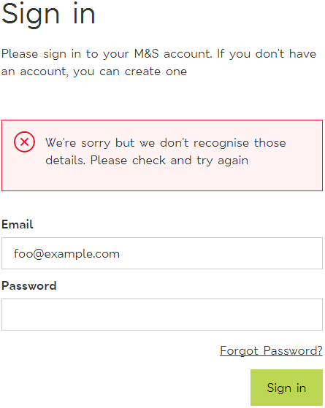
Good

Slide 29
Account presence leaking
All the same-origin policy stuff we’ve already seen
Failure messages for:
Account creation
Account login failed
Account password reset
And one more thing…

Slide 30
Demo
Hashing
Notes:
https://www.catsatdevweek2016.co.uk/session/login
POST
Content-Type: application/x-www-form-urlencoded
email=mia%40red-gate.com&password=whatever
Also if not careful, a denial-of-service attack, so typically there’s a CAPTCHA here, which also protects against brute-force password guessing attack
https://github.com/DavidSimner/cats/blob/master/Services/LoginService.cs

Slide 31
Cookies

Slide 32
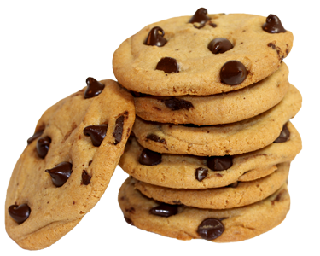
My favourite food
Notes:
But also a data storage mechanism

Slide 33
Cookie rules
Set-Cookie: <name>=<value>[; <name>=<value>]...
[; expires=<date>]
[; domain=<domain_name>]
[; path=<some_path>]
[; secure]
[; httponly]
Notes:
Explain the rules with domain
Supercookies: https://publicsuffix.org/
Expires decides session vs permanent
Chrome’s “On start-up, Continue where you left off” essentially makes session cookies permanent

Slide 34
Tip: Set-Cookie httponly
Set the response header:
Set-Cookie
With the option:
httponly
Notes:
Mitigates damage from XSS attacks

Slide 35
Tip: Set-Cookie secure
Set the response header:
Set-Cookie
With the option:
secure
Notes:
Mitigates damage from HTTP
We’ll see in a minute that this isn’t sufficient, and there’s actually a better way
But you should set it anyway because Defense in Depth
Let’s see how secure isn’t sufficient by itself…

Slide 36
Demo
http://evil.www.catsatdevweek2016.co.uk/setcookie.html
Notes:
Session fixation
Emphasise that the URL is HTTP because the attacker can’t get a HTTPS certificate for the attacker’s domain
This attack relies on being on the same Wi-Fi network to do a man-in-the-middle attack on DNS requests
What we saw here was an attacker setting cookies, but he can also read them, if the web browser sends them to his server

Slide 37
Tip: HSTS includeSubDomains
Set the response header:
Strict-Transport-Security
With the option:
includeSubDomains
And the option:
preload
Then, register at:
https://hstspreload.appspot.com/
Notes:
Also, with HSTS, the user can’t override any security warnings, so the old trick of giving the user an invalid certificate, and hoping they click through the browser’s security warnings doesn’t work any more
Alternatively DNSSEC
https://developer.mozilla.org/en-US/docs/Web/Security/HTTP_strict_transport_security

Slide 38
Subresource Integrity (SRI)
Notes:
What it is
What it protects you against, i.e. a CDN infected with malware
Any whitespace changes, for example, even line ending differences mean the hash changes and it won’t load

Slide 39
Summary

Slide 40
Summary
Understand the things
Do the right things:
https://securityheaders.io/
https://www.ssllabs.com/ssltest/
Incentivise your users:
MailChimp gives users a 10% discount for enabling 2FA
Whereas, Trello charges for SSO (Trello Enterprise)
Keep learning
Notes:
Google

Slide 41
</talk> any questions?

Slide 42
Any questions?
Slides: www.davidsimner.me.uk
Email: david.simner@red-gate.com

